Slide 1
Older People With Psychosis In Primary Psychiatric Diseases
Faranak Zakizadeh
MD, Assistant Prof of Psychiatry
Isfahan University of Medical Sciences

Slide 2
Late Life Or Late Onset?
Late life :
The onset may occur in earlier adult-hood with a recurrent course into older age
late onset :
First-onset of episodes of disorder after 60 years

Slide 3
Major Depressive Disorder:
After 60 years are common , making up about one-half of all episodes in older adults.
It is important to distinguish early-onset depression (EOD) with recurrent depressive episodes in later years from late-onset depression (LOD), in which a depressive illness develops for the first time in later life
Schizophrenia:
late-onset schizophrenia (onset age 45 to 60)
very-late–onset schizophrenia-like psychosis (onset over 60)

Slide 4
Psychosis In The Elderly
Functional:
Affective Disorder
Schizophrenia spectrum
Delusional Disorder
Organic:
Delirium
Dementias

Slide 5
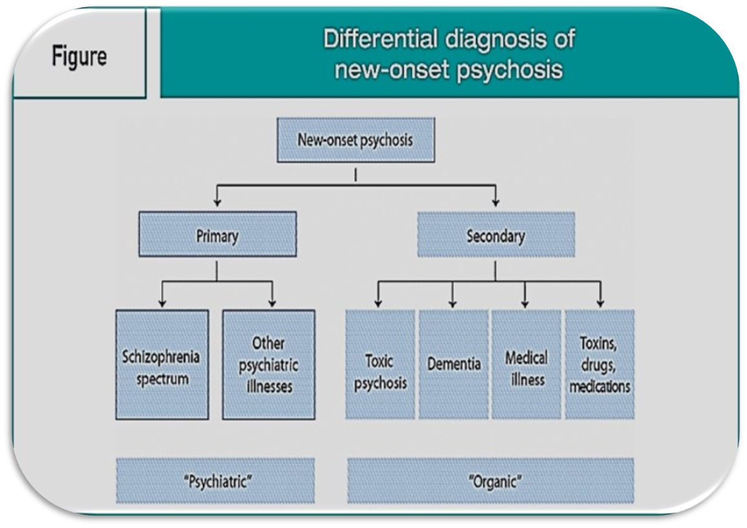

Slide 6
Affective Disorders
Psychotic Depression
Occurs in 20 to 45 percent of hospitalized elderly depressives and in 3.6 percent of elderly depressives living in the community.
Patients with psychotic depression have delusions, whereas hallucinations are less frequent.
Delusions are more commonly mood- congruent.
The usual themes of depressive delusions are guilt, hypochondriasis, nihilism, persecution, and sometimes jealousy.
Auditory hallucinations are less common and not easily described, such as vague derogatory voices.

Slide 7
Geriatric Bipolar Disorder
In contrast to younger patients, who tend to present with elevated or irritable mood, older adults more often display a mixed symptom picture with the concurrent presence of depressive and manic symptoms.
Paranoid delusions become more frequent with aging and may occur along with mood congruent delusions .
Also presents with predominantly mood-congruent delusions such as grandiosity, erotomania, delusions about possessing special powers.

Slide 8
Irritability is more common than hyperactivity
Circumstantiality is often seen instead of flight of ideas
More cognitive impairment
less likely to show increases in activity, sexual interest, religiosity, initiating and making plans

Slide 9
Less severe manic episodes
More likely to relapse into depression after a manic episode
Less likely to experience psychotic symptoms
More likely to experience rapid cycling
Less likely to attempt suicide

Slide 10
Relapse and hospital readmission after manic episodes are common as episodes become more frequent and the interval between episodes becomes shorter with age.
These differences in the presentation of mania in later life decrease the sensitivity of the DSM-5 criteria as a diagnostic tool for geriatric mania.

Slide 11
SchizoAffective Disorder
There must be a mood episode that occurs simultaneously with the active-phase symptoms of schizophrenia and they must be present for a substantial proportion of the active and residual periods of the illness.
Additionally, delusions or hallucinations must be present for at least 2 weeks in the absence of prominent mood symptoms.
Gender differences:
Equal numbers of men and women who have the bipolar subtype
More than twofold female to male predominance among individuals with the depressed subtype

Slide 12
If the mood symptoms have
A duration that is brief in relation to the total duration of the disturbance,
Occurs only during the prodromal or residual phases,
Do not meet full criteria for a major depressive disorder, manic disorder, or mixed episode,
Then a diagnosis of schizoaffective disorder cannot be made.
Patients with remissions between schizophrenic episodes may be diagnosed as schizoaffective on one occasion and schizophrenia with mood disturbances on another occasion depending on levels of symptom severity and duration.

Slide 13
LATE-ONSET SCHIZOPHRENIA
Epidemiology
The prevalence remains unclear.
Review of studies of late onset schizophrenia found that 20-25% of patients with schizophrenia had an onset of the disorder after age 40.
Fe/M=2-10
Hypothesis that estrogen-mediated dopaminergic inhibition may protect younger women from schizophrenia.
The incidence of schizophrenia is still considerably higher in younger versus older women

Slide 14
Early and Late-Onset Schizophrenia
Similarities:
Genetic risk
Presence and severity of positive symptoms
Early psycho-social maladjustments
Subtle brain abnormalities
Differences:
Better function
Fewer negative symptoms
Better neuropsychological performance
Better response to antipsychotics
lower severity of cognitive impairments
More likely to be female
Better premorbid functioning

Slide 15
The most common features of late-onset schizophrenia are persecutory delusions that may be bizarre and auditory hallucinations.
Tended to have more persecutory delusions with and without hallucinations, organized delusions, and abusive auditory hallucinations or hallucinations with a running commentary.
The course of late-onset schizophrenia is usually chronic but may be interrupted by partial remissions.
The prognosis is somewhat better than that in early-onset schizophrenia.

Slide 16
Very-Late–Onset Schizophrenia-Like Psychosis
“Very-Late–Onset Schizophrenia-Like Psychosis” is distinguished from the other two types by :
More brain abnormalities an neuropsychologic deficits
More females
Greater prevalence of persecutory and partition delusions
Higher rates of visual, tactile, and olfactory hallucinations
Lower genetic load

Slide 17
More sensory abnormalities
Absence of negative symptoms
Low prevalence of thought disorder and affective blunting
Higher prevalence of visual hallucinations.

Slide 19
Delusional Disorder
Characterized by :
Delusional disorder is differentiated from schizophrenia by :
Lack of prominent auditory or visual hallucinations
Absence of deterioration in areas of functioning outside the delusional scope.
The delusions are necessarily non bizarre and involve situations that may occur in real life, such as theft, suffering from a disease, or spousal infidelity.
Persecutory delusions are most commonly seen.

Slide 20
Common types of delusions seen in elderly patients with delusional disorder are:
Skin infestation by insects
Organs, such as a liver, are cancerous
The person is being spied on, followed, or poisoned
The spouse is unfaithful

Slide 21
Auditory and visual hallucinations, if present, are not prominent.
Hallucinations in other modalities, like olfaction and touch, can be present in relation to the delusional theme, e.g., tactile hallucinations along with delusions of infestation
Epidemiology
Studies suggest that between 2 and 8 percent of the elderly population experiences some type of paranoid symptoms.
The overall prevalence of delusional disorder is slightly higher among women than among men.

Slide 22
Etiology
Several factors have been postulated to contribute to the development of delusional disorder:
Family history of schizophrenia
Avoidant, Paranoid, Schizoid personality disorder
Hearing loss
Being an immigrant
Low socioeconomic status

Slide 23
Studies aimed at establishing a genetic component to delusional disorder have been unable to either confirm or establish such com ponent.
There are no clear neuroanatomical changes associated with delusional disorder.
There is mixed evidence that hearing or visual abnormalities might play a role in the development of delusional disorder.

Slide 24
Course and Prognosis
May vary but tends to be chronic, especially in those with the persecutory type of delusional disorder.
A waxing and waning of the preoccupation with the delusional beliefs often occurs, and in other cases, full periods of remission may be followed by subsequent relapses.
In some cases, the disorder remits within a few months, often without subsequent relapse.

Slide 25
Psychosis Associated with Cognitive Disorders or Due to a General Medical Condition
A patient who presents with psychotic symptoms after the age of 45, particularly if the symptoms develop after the age of 60, requires a thorough evaluation for underlying medical disorders.
The onset of hallucinations and delusions in later life can arise de novo or be associated with:
Sensory deficits
Poly pharmacy
Substance abuse
Medical disorders
Dementia

Slide 26
Thank You for Your Attention

